Slide 1
Data Link Layer Part IV: Medium Access Control with Carrier Sense

Slide 2
What is the biggest problem with ALOHA
The stations do not listen to the channel before they transmit ➔ transmit even there is already a frame on the channel
Collision is inevitable!

Slide 3
Carrier Sense Multiple Access (CSMA) Protocols
In a shared medium network, it is possible for computers to detect whether other computers are transmitting or not
Carrier sense protocols:
Unlike ALOHA
Stations listen for a carrier (i.e., transmission) and act accordingly
These protocols have a much better throughput rate ( % of successfully transmitted frames) compared to ALOHA.

Slide 4
Carrier Sense Multiple Access (CSMA) Protocols
Improve throughput by decreasing collisions
Sense existing traffic
Include randomness to avoid repeated collision
Persistent vs non-persistent
persistent protocols continuously sense the channel
non-persistent protocols wait for a random time before rechecking
Collision Detection and acting for it
avoids sending the rest of a frame once collision has occurred

Slide 5
Carrier Sense Multiple Access (CSMA) Protocols
There are several types of CSMA
protocols:
1-persistent CSMA
nonpersistent CSMA
p-persistent CSMA

Slide 6
1-persistent CSMA
When a station has data to send, it first listens to the channel to see if it is busy
If channel busy
→ the station goes on listening to see when it becomes idle
When the station detects an idle channel
→ it transmits a frame
While transmitting the frame, station listens to channel to see if collision
If collision
→ station waits a random amount of time and attempts to transmit again (starts all over again)
The protocol is called 1-persistent because the station transmits with a
probability of 1 whenever it finds the channel idle.

Slide 7
1-persistent CSMA
Q: How can there be a collision if the station does not transmit if the channel is busy

Slide 8
1-persistent CSMA
A1: Simultaneous transmissions
Example: Three stations A, B, C
A is transmitting
B and C become ready in the middle of A’s transmission
B and C will wait until the end of A’s transmission
Both will begin transmit simultaneously, resulting in a collision
If B and C were not so greedy, there would be fewer collisions

Slide 9
1-persistent CSMA
A2: Propagation delay
Right after a station begins sending, another one becomes ready to send and senses the channel
If the first station’s signal has not reached the second one, then the second will sense an idle channel, begin sending→ COLLISION
The longer the propagation delay, the worse this effect is

Slide 10
nonpersistent CSMA
In this protocol, an attempt is made to be less greedy than 1-persistent CSMA
Before sending, a station senses the channel
If channel idle → begins sending
If busy → wait for a random time before listening again
If idle → it transmits its frame.
Advantage: Instead of waiting for the channel to become idle as in the 1-persistent case, on detecting that the channel is busy, a station waits for a random time before listening again.
Intuitively, it has better channel utilization and longer delays than
1-persistent CSMA.

Slide 11
Tradeoff between 1- and Non- Persistent CSMA
Example: Three stations A, B, C
A is transmitting
If B and C become ready in the middle of A’s transmission
1-Persistent: B and C collide
Non-Persistent: B and C probably do not collide
If only B becomes ready in the middle of A’s transmission,
1-Persistent: B succeeds as soon as A ends
Non-Persistent: B may have to wait

Slide 12
p-persistent CSMA
Applies to slotted channels
When station A is ready to transmit, it senses the channel
If the channel is busy A waits for the next slot
If the channel is idle
A decides to transmit with a probability p
If A decided not to transmit AND another station starts transmitting → A waits for a random time and restarts the algorithm (A observes that there is some traffic on the channel and does not send additional traffic)
It is possible that there is some other B that is also sensing the same channel and deciding whether to send with probability p
If A and B transmit in the same slot → collision →A waits for a random time and restarts the algorithm (A observes that there is some traffic on the channel and does not send additional traffic)

Slide 13
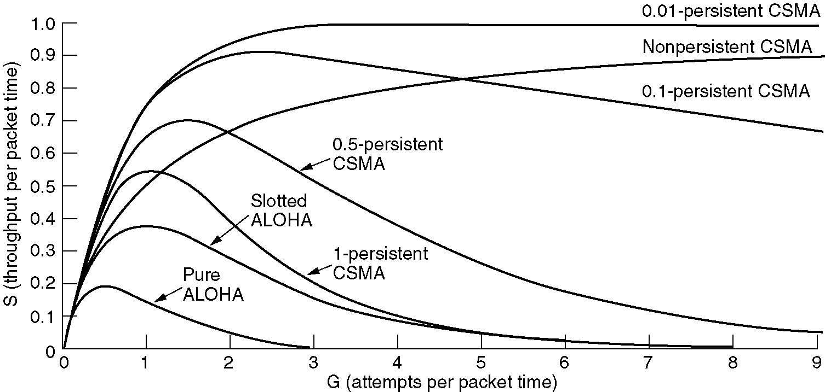
Comparison
CSMA has better channel utilization (and longer delays than ALOHA)

Slide 14
CSMA/CD (Collision Detection and doing something about it!)
CSMA an improvement over ALOHA because no station transmits when it senses the channel busy
Another improvement: stations abort their transmissions as soon as they detect a collision
if two stations sense the channel idle and begin transmission simultaneously they will both detect the collision immediately
Rather than finishing transmitting their frames, which will be corrupted, stop transmitting frames as soon as collision detected
Quickly terminating damaged frames saves time and bandwidth!
This protocol is called CSMA/CD (Carrier Sense Multiple Access with Collision Detection).

Slide 15
CSMA/CD (Collision Detection and doing something about it!)
CSMA/CD: carrier sensing, deferral as in CSMA
collisions detected within short time
colliding transmissions aborted, reducing channel wastage
persistent or non-persistent retransmission
Collision detection:
easy in wired networks: measure signal strengths (power or pulse width), compare transmitted, received signals
difficult in wireless networks: receiver shuts off while transmitting

Slide 16
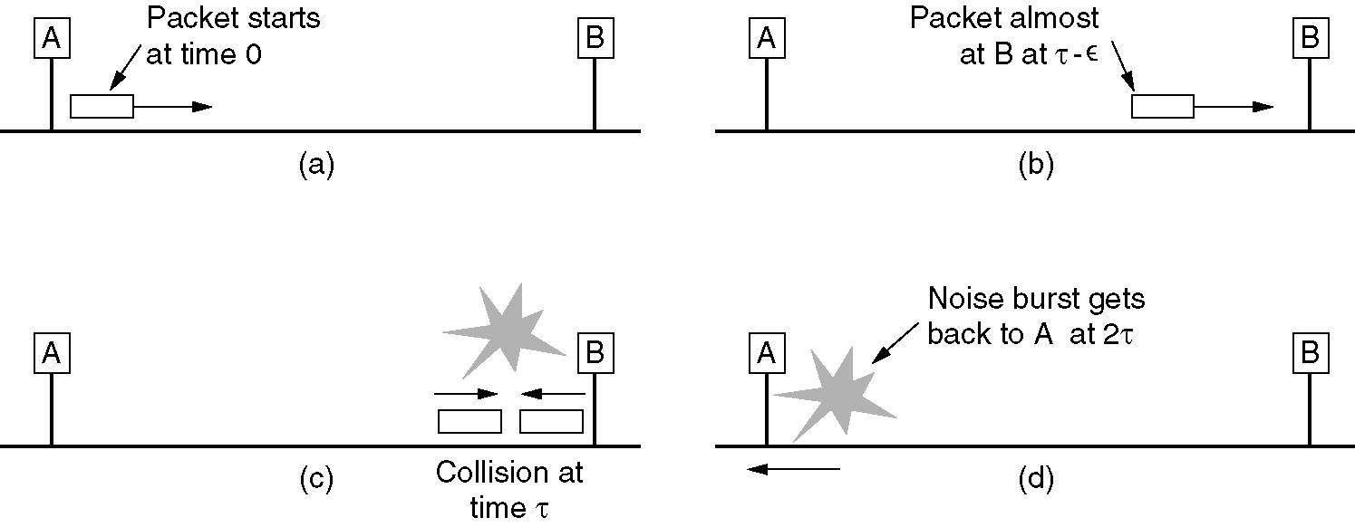
CSMA/CD Time to Detect Collision
Let the time for a signal to propagate between two farthest stations be τ
It takes 2τ seconds for two stations to realize that there has been a collision after starting the transmission

Slide 17
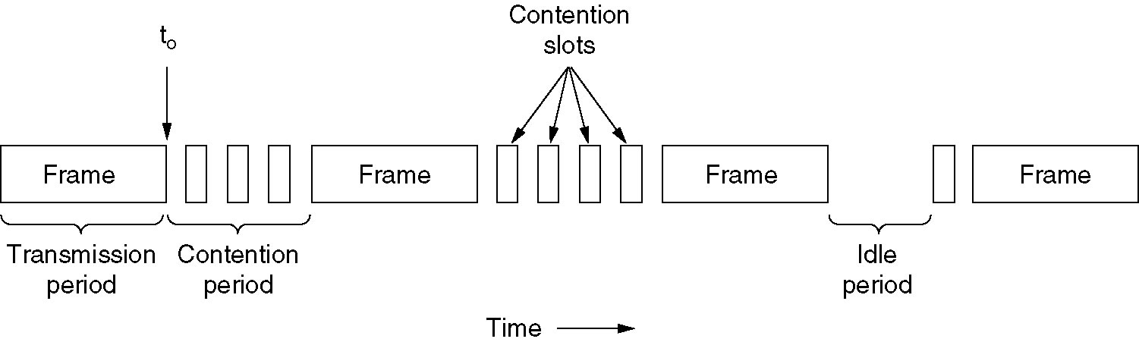
CSMA/CD
The minimum time it takes to detect a collision is just the time it takes for the signal to propagate from any computer to any other computer and back again → 2τ Slot Time
E.g., for a 1km long cable: τ=(1000 m)/ (2x10⁸ m/sec)=5 μsec
Contention Period: modeled as a Slotted ALOHA System with Slot Time of 2τ
CSMA/CD can be in one of three states: contention, transmission, or idle.

Slide 18

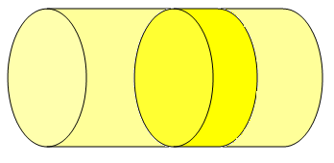
CSMA/CD Propagation delay and collision detection
D1
Define parameter α=D/T
D: max propagation delay between any 2 stations
T: time takes to transmit an average size packet
α: is the # of packets (or a fraction of a single packet) that a transmitting station can place in the medium before the station farthest away receives the first bit
when α is small (<<1)
prop. delay is a small fraction of packet transmission time
every station in the network receives some part before the transmission is finished
when α small collision detection is fast
CSMA/CD is not very useful for high bandwidth-delay product links ➔ large α
Link 1
α1=D1/T1
T1
D2
Link 2
α1< α2
T2
α2=D2/T2
Volume of the link pipe= Bandwidth x Delay

Slide 19
CSMA/CD Performance
Assume:
k stations are always ready to transmit
constant retransmission probability in each slot
If each station transmits during a contention slot with probability p, then the probability A that some station acquires the channel in that slot is

Slide 20
CSMA/CD Performance
For k users, which p maximizes A?
A is maximized for p=1/k with A→1/e as k→∞
( also for k→1, A→1 )
The probability that the contention interval has exactly j slots in it is
The mean number of slots per contention:

Slide 21
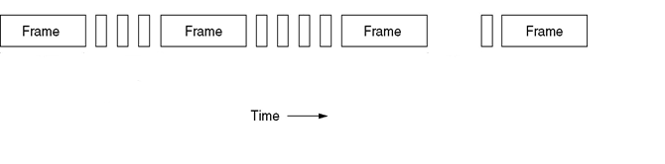
CSMA/CD Performance
The mean number of slots per contention (including the last slot that captures):
Contention interval i
Contention interval i+1
Contention interval i+2

Slide 22
CSMA/CD Performance
What is the mean contention interval?
slot length x (mean no. of contention slots)
Each slot has a duration 2τ
Assuming optimal p, A=1/e,
w= 2τe =5.4τ =276.5μs
Longer cable → longer contention interval

Slide 23
CSMA/CD Performance
If the mean frame takes P seconds to transmit →
Assume (for optimal p, A=1/e)
F: frame length (bits)
B: bandwidth (bps)
L: cable length (m)
c: speed of signal propagation (m/s)
Time to transmit
Time to capture and then transmit

Slide 24
Numeric Example
Find the maximum achievable user data rate for a 2.5km long coax. cable with a 10Mbps transmission rate and 620-bit packets with 30B header. Signal propagation
speed in coax is 2.3x10⁸m/s.
Time to capture and then transmit
If the network transmits packets with 30B header user data=620-30x8=380bits
380bits/120μs=3.16Mbps
Max. user data rate

Slide 25
A more interesting Example
In an experimental 1-persistent 1Mbps CSMA/CD network with 10 stations, each station is independently generating (transmitting) Poisson traffic of 1024B frames at an average rate of 10 frames/sec. The contention slot is 1/128 sec.
a) Find the probability of collision occurring in a contention slot.
Three mutually exclusive events can happen for a contention slot:
No station transmits➔ Medium stays idle : with probability P_{I}
Only one station transmits➔ Successful capture of the medium: with probability P_{S}
More than one station transmit➔ Collision: with probability P_{C}

Slide 26
Example ctd’
No station transmits➔ Medium stays idle : with probability P_{I}
P₀: probability that a station remains silent
P_{I}: probability that all 10 stations remain silent=P₀¹⁰
Poisson expression with rate λ (events/unit time):
λ=10 fr/sec, t=1/128 sec
P₀=Pr [0 transmissions in one slot time]

Slide 27
Example ctd’
Only one station transmits➔ Successful capture of the medium: with probability P_{S}
More than one station transmit➔ Collision: with probability P_{C}

Slide 28
Example ctd’
b) Find the average length of a contention interval.

Slide 29
Example ctd’
c) What is the average time taken to successfully deliver a frame? (Any frame)
Average time to successfully deliver a frame=contention time + frame transmission time

Slide 30
Example ctd’
d) What is the average data rate observed by one of the MAC users if the CSMA/CD protocol header inside the 1024B frame is 32B long?
t_{f} is the time period with which the network delivers frames. Each individual station
experiences 10 times this delay due to each station capturing the medium with equal probability. Therefore,

Slide 31
Data Link Layer Part IV: Medium Access Control with Carrier Sense

